Slide 1
Develop a Linux Scheduler using Golang!
Ian Chen / 陳毅

Slide 2

About me
Founder at Gthulhu
Software Engineer at Saviah
Adjunct Faculty at NYCU
2 x Microsoft MVP
TSC Member[at] free5GC
Book author

Slide 3
Outline
Introduce to eBPF
Background
Toolchain
struct_ops & sched_ext
The scx_rustland
Architecture
Design
The scx_goland
How to develop your own scheduler with scx_goland_core
Future Work
Q&A

Slide 4
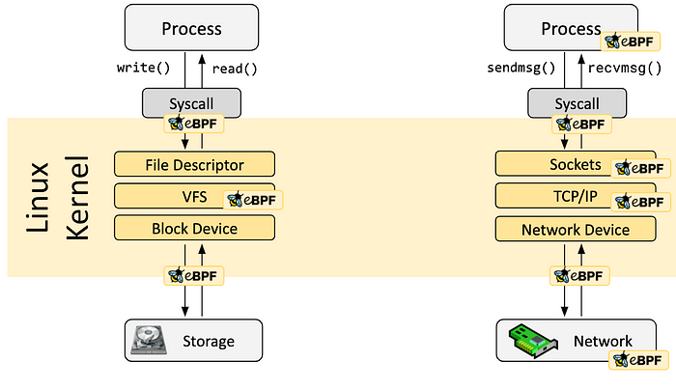
eBPF（extended Berkeley Packet Filter）
It has no direct connection to BPF.
PLUMgrid originally developed it as an SDN core module (iovisor.ko)
It was contributed upstream to gain acceptance and evolve into eBPF
eBPF programs can be injected into various systems within a system to detect and even influence various system behaviors

Slide 5
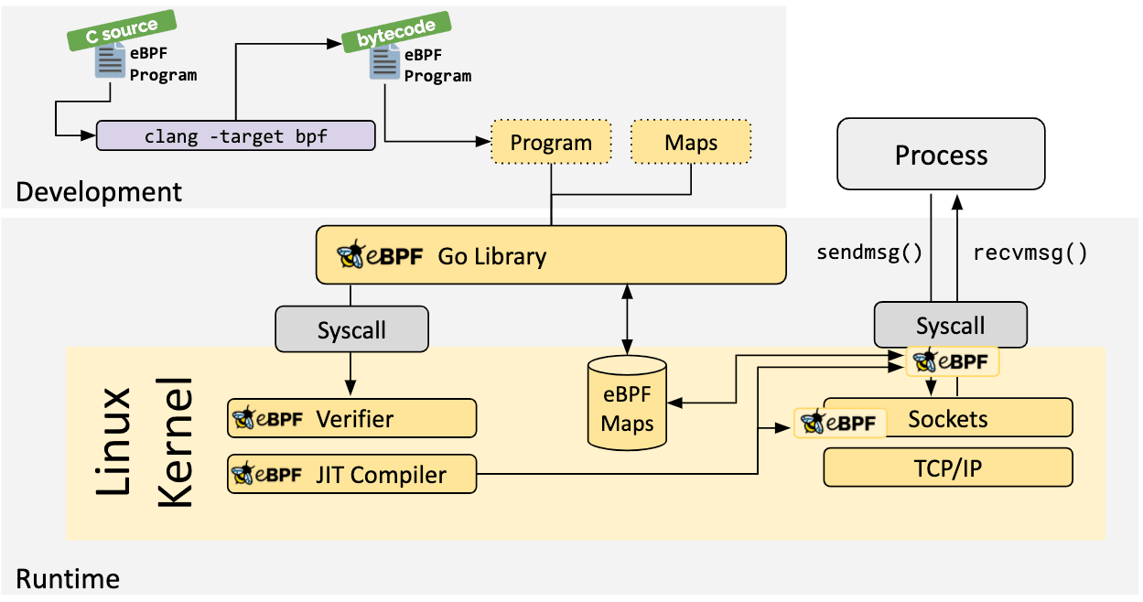
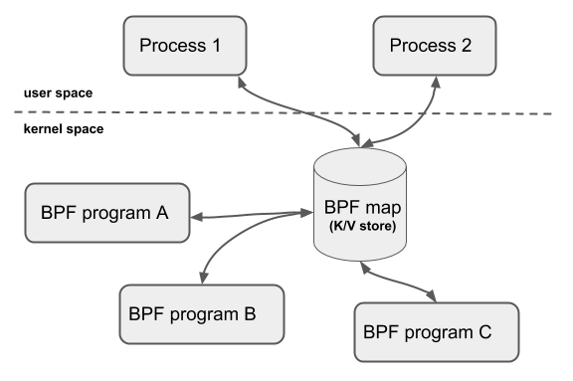
eBPF（extended Berkeley Packet Filter）
The user space process is responsible for managing eBPF programs and eBPF maps. It can be bpftool, bcc, or a user-developed program (usually used in conjunction with libbpf)

Slide 6
eBPF（extended Berkeley Packet Filter）
As more technology giants invest in the eBPF ecosystem, eBPF is equipped with additional capabilities. ：
Tracing：kernel functions call、cGroup
Network：traffic control、XDP、netfilter
Security：Linux Security Module
Meta added the struct_ops type of eBPF program to develop customized TCP congestion control using eBPF.

Slide 7
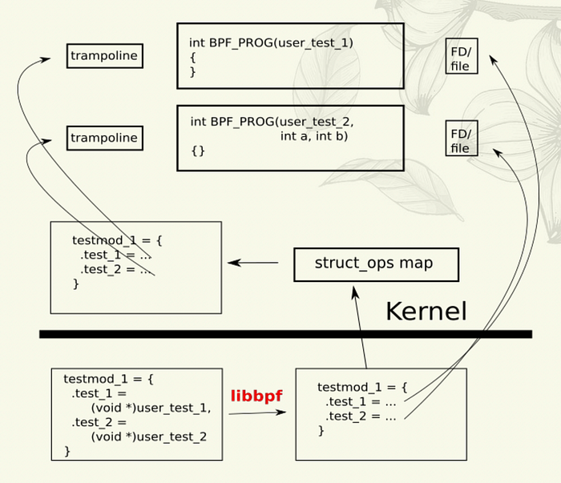
struct ops
struct_ops is essentially an eBPF map that records the eBPF program(s) that implement the kernel interface:
Ref: https://lpc.events/event/17/contributions/1607/attachments/1164/2407/lpc-struct_ops.pdf

Slide 8
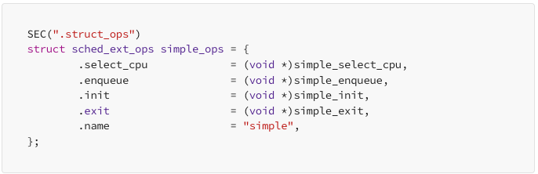
Scheduler extension (sched_ext)
Since Linux kernel v6.12, sched_ext has been officially supported. Developers only need to use the relevant APIs and take advantage of struct ops to develop customized schedulers with eBPF!

Slide 9
Scheduler extension (sched_ext)
Each CPU has its own DSQ（Dispatch Queue）
The system will have a default global DSQ
Developers can add more DSQs using the API
Details: https://medium.com/@ianchen0119/ebpf-%E9%9A%A8%E7%AD%86-%E4%B8%83-sched-ext-f7b60ea28976
Example: https://github.com/sched-ext/scx/blob/main/scheds/c/scx_simple.bpf.c

Slide 10
Scheduler extension (sched_ext)
Back to the point, sched_ext is the extension interface defined by the Linux kernel for the scheduler subsystem, allowing us to develop customized schedulers using struct_ops.
So… how does developing a scheduler with eBPF relate to gopher…?

Slide 11
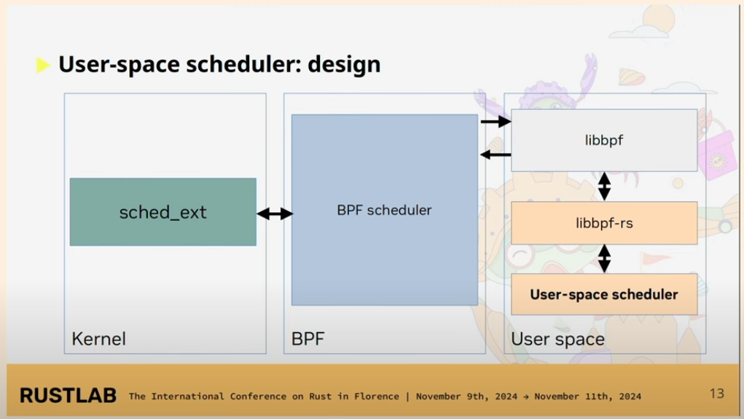
scx_rustland
Andrea Righi, an engineer at NVIDIA, came up with a brilliant idea: to pass scheduled processes to a user-space process using the eBPF map mechanism, allowing it to decide on the schedule. The user-space process then passes the decision back to the eBPF program via the map. This idea became the Rustland scheduler (a user-space program developed in Rust) under the scx project.
Ref: https://www.youtube.com/watch?v=L-39aeUQdS8

Slide 12
scx_rustland
The core design of scx_rustland is as follows:
Kernel threads bound to specific CPUs are directly scheduled by the eBPF program.
Userspace programs are themselves directly scheduled by the eBPF program.
The userspace program considers the CPU topology (cache) when selecting a CPU for a given task.
The userspace program considers voluntary context switches when setting deadlines for a given task.
The userspace program allocates a variable time slice to a given task (depending on how many tasks are currently queued).
Ref: https://www.youtube.com/watch?v=L-39aeUQdS8

Slide 13
scx_goland
After watching Andrea's talk, I thought, "Golang could definitely fulfill the role played by Rust in scx_rustland." After all, Go has...
Cgo
Libbpf-go: A Golang version of libbpf wrapped by aqua security
Smart memory and thread management mechanisms
Ref: https://www.youtube.com/watch?v=L-39aeUQdS8

Slide 14
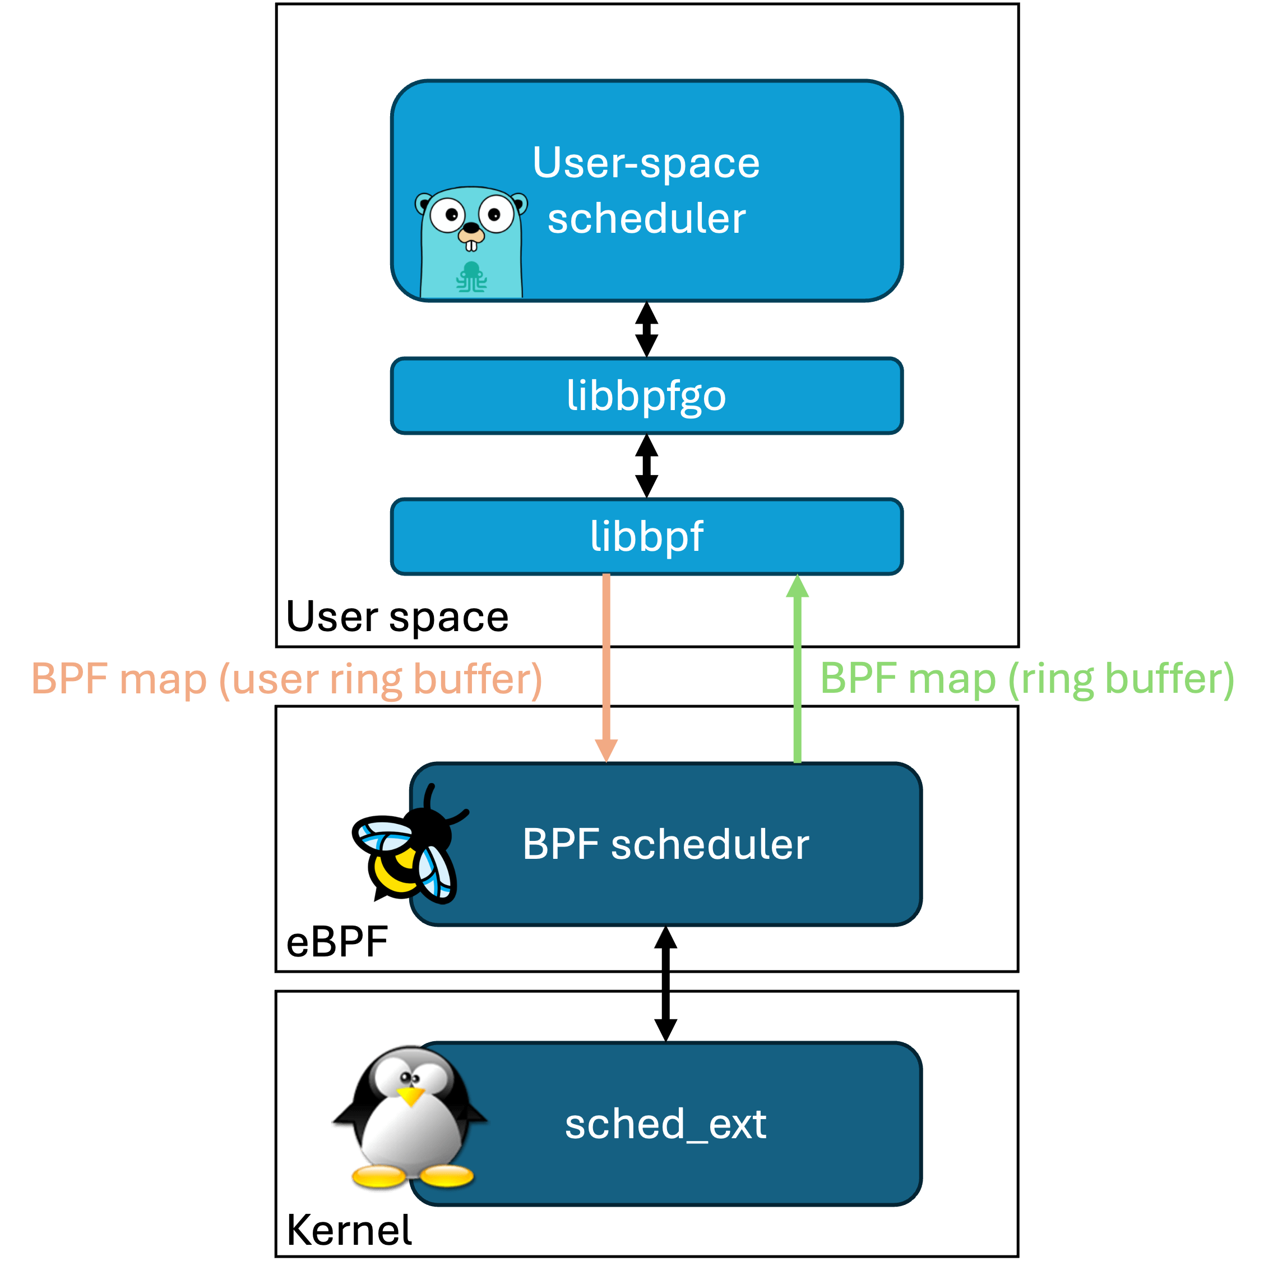
scx_goland
Initial concept:
The userspace program calls the libbpf-go API to load the eBPF program.
Then, retrieve scheduled tasks from the eBPF program via the ring buffer.
Implement an EDF scheduler based on voluntary context switches.
Then pass the decision to the eBPF program via the user ring buffer.

Slide 15
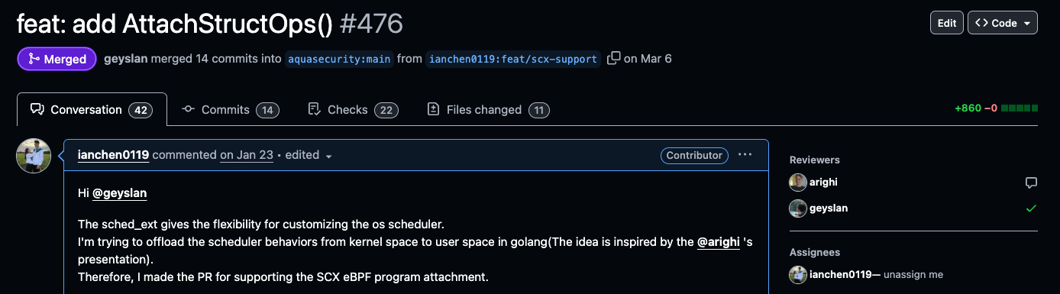
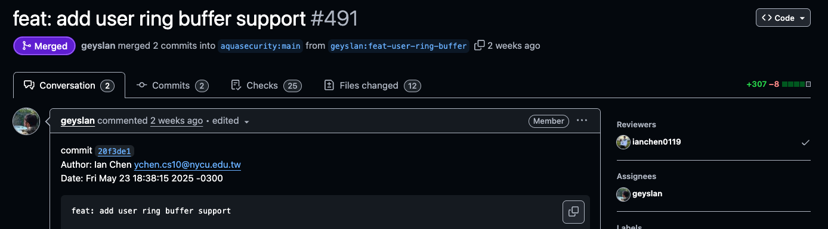
scx_goland
Libbpf-go does not support user-ring buffer map-related operations
Libbpf-go does not support struct-ops related operations

Slide 16
scx_goland
After resolving the toolchain issue, I finally managed to load the eBPF scheduler! However…
After loading, the system froze for 5 seconds before the scheduler was kicked out… 🤔

Slide 17
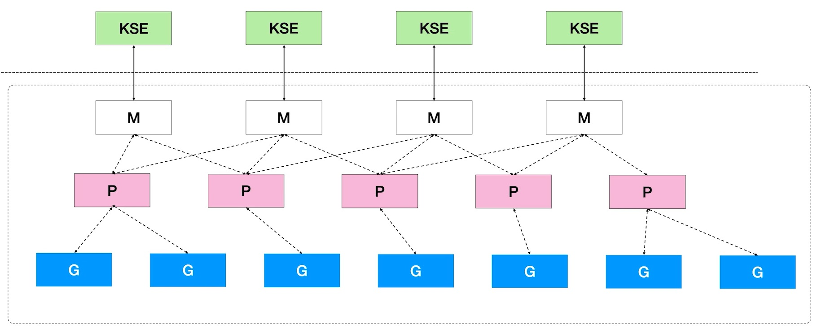
scx_goland
After a few nights of thinking, I finally found the problem:
Notes:
第一時間我是去限制 GOMAXPROCS 的數量

Slide 18
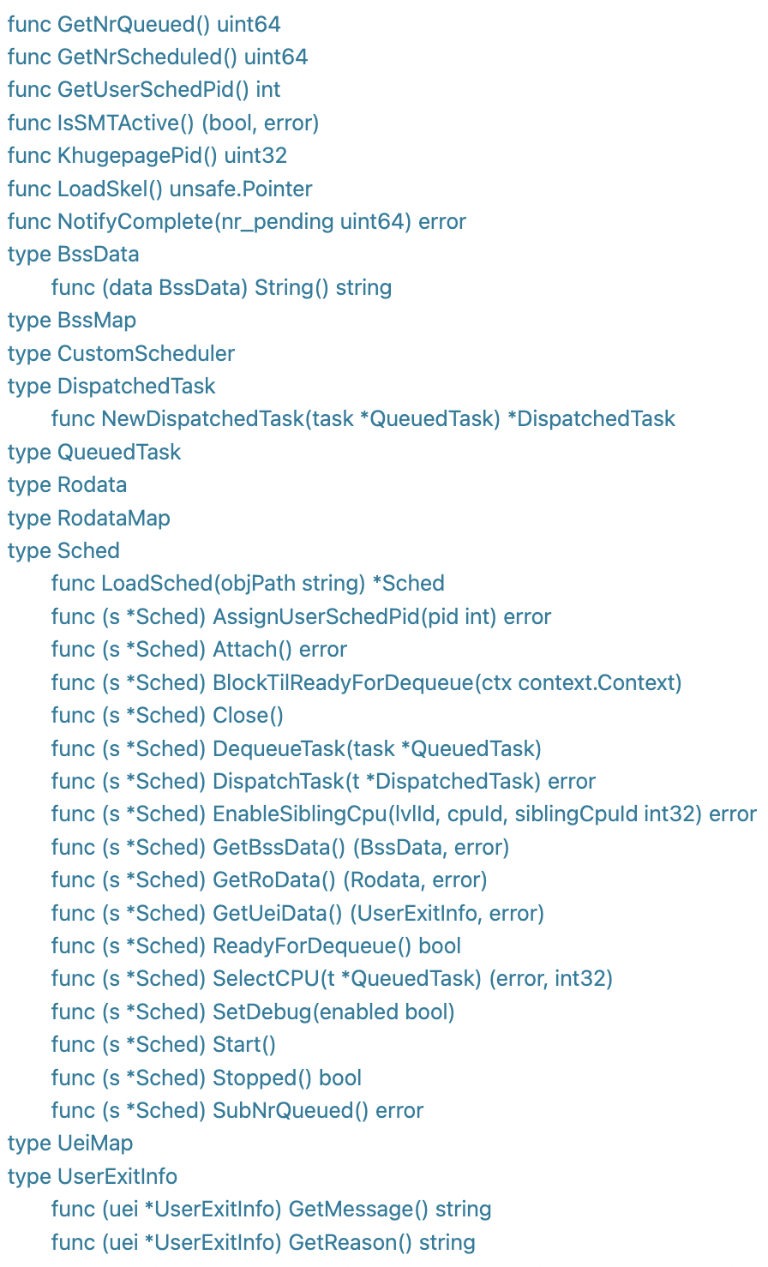
scx_goland_core
scx_goland_core can receive scheduler events from Kernel Space. Therefore, all scheduler logic can be implemented in golang:

Slide 19


Next Step: Gthulhu
After completing the first version of scx_goland_core, I began to ponder a few questions:
Who is the framework's target audience?
What pain points can I solve with it?
To this end, I proposed a concept called Scheduling Policy as Configuration. Users can adjust the scheduling logic of each machine in a multi-node cluster simply through a RESTful API.
Large-scale language models and service observability offer the potential for AI to dynamically adjust scheduling logic based on existing performance metrics to optimize workload processing capabilities.

Slide 20
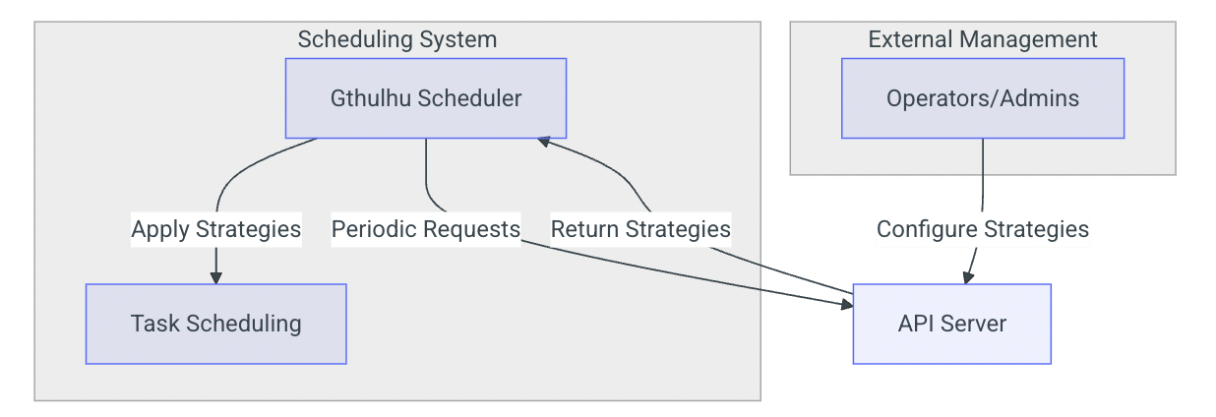
Next Step: Gthulhu
To solve this problem, Gthulhu was born!
Gthulhu is currently optimized for specific workloads based on user-provided configuration files. Next, we will attempt to:
Optimizing network issues
Developing a multi-cluster management system
Accumulating more case studies
CNCF landscape
https://gthulhu.github.io/docs/

Slide 21


Q&A

